Slide 1
DOELAP Assessor Training After the Assessment
Idaho Falls, ID
September 2024

Slide 2
After the Assessment
Remember
The STM, the Oversight Board (OSB), and the DOELAP Administrator were not at the assessment
The subsequent accreditation process depends, in part, on how well you communicate the evidence, context, and seriousness of the findings
The STM has the discretion to recommend changing the status of a finding
DOELAP policy is to support your findings

Slide 3
After the Assessment The Assessment Documents
Send completed assessment report, assessment checklist, and attendance sheets to the Senior Technical Manager (STM)
Hardcopy – original assessment report, assessment checklists, attendance sheets, and other supporting documentation
Electronic copy (word document) – assessment report without signatures

Slide 4
After the Assessment The Corrective Action Plan
STM receives the corrective action plan from the participant through the DOE Field/Site Office
“officially” must come through field office
“Reality” routing through field office takes a lot of time
Draft CAPs may be acceptable
Sites are encouraged to consult with STM on proposed CAPs
STM forwards the corrective action plan to the assessment team
Email response to the STM

Slide 5
Preparation of Site Accreditation Recommendation Packages
The evidence is assembled into an accreditation package for each applicant in the test session
The site accreditation package includes:
The STM letter of recommendation (or not)
Application
Performance testing results
On-site assessment report
Response to the assessment report (if required); STM must receive the corrective action plan within 45 calendar days of assessment’s exit briefing

Slide 6
Oversight Board Review of The Recommendation Packages
Each OSB member is provided the package for review prior to the OSB meeting
Each section of the package is reviewed with time provided for discussion of each section
Questions may be asked of the STM as needed
Final discussions and opinions are presented at the end of the package review
OSB members concur with the STM recommendation, concur with contingencies, or may disagree with STM recommendation
OSB members recuse themselves from voting on their own site

Slide 7
Granting Accreditation
The DOELAP Administrator issues a Certificate of Accreditation and the Conditions of Accreditation
Certificate of Accreditation
Issued to recognize the accreditation of the dosimetry program
Names the accredited program and the effective dates of the accreditation
DOELAP Administrator’s signature
Only the DOELAP Administrator can grant DOELAP accreditation

Slide 8
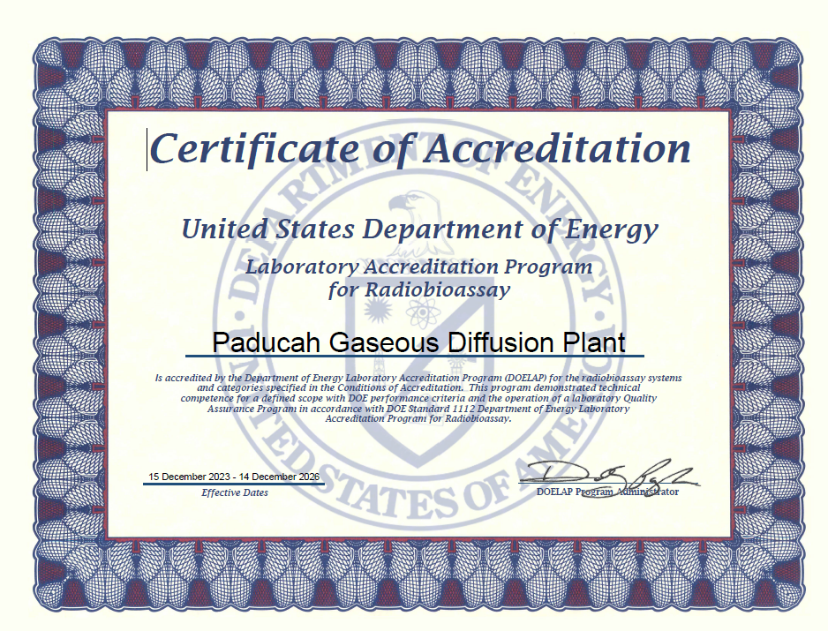
Granting Accreditation
XYZ National Laboratory

Slide 9
Granting Accreditation
Conditions of Accreditation
Issued along with the Certificate of Accreditation
Lists the measurement categories, the nuclides, matrices, and counting systems that are being accredited
Includes the effective end date
DOELAP accreditation typically expires three years from the effective date

Slide 10
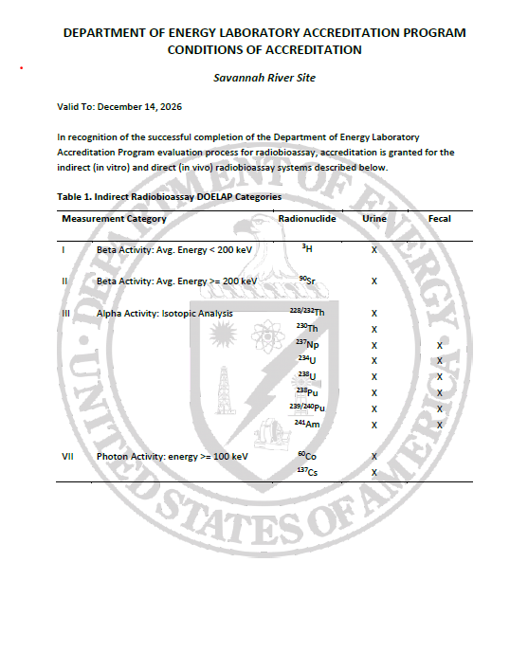
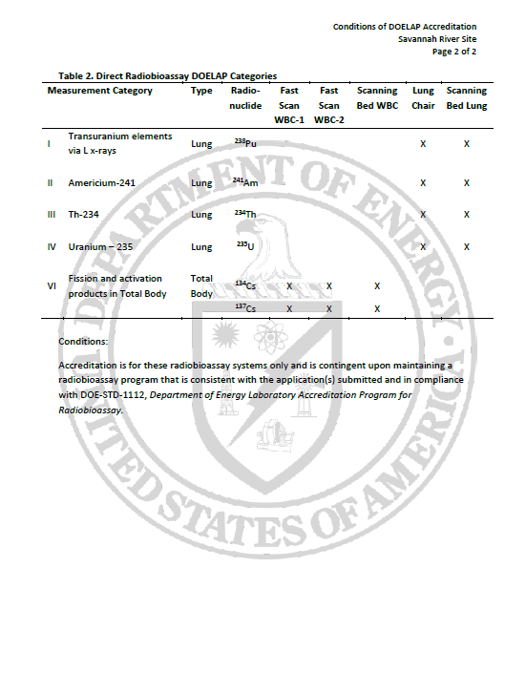
Granting Accreditation
XYZ National Laboratory
XYZ National Laboratory

Slide 11
Granting Accreditation
DOELAP wants successful applicants, i.e., radiobioassay programs
The assessment report and the input provided by assessors is critical
Failure is an option
DOELAP accreditation is not a gift

Slide 12
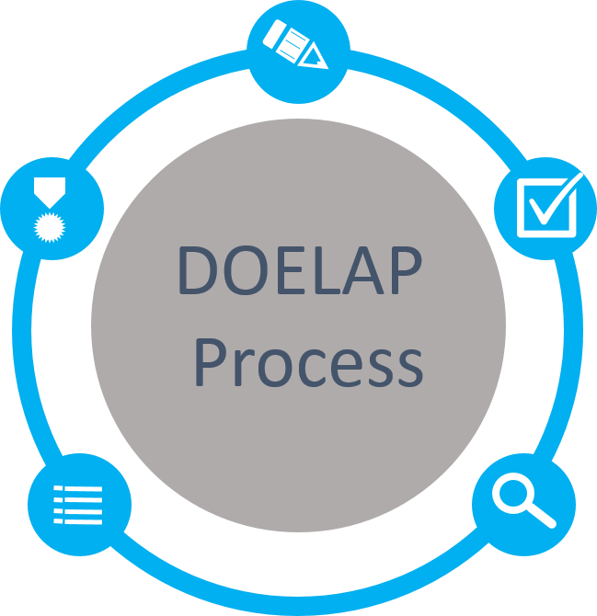
The DOELAP Circle of Life
Application
Quality Assurance Program
Field Office Review
Performance Testing
ANSI N13.11, Personnel Dosimetry Performance Criteria and Testing
ANSI N13.32, Performance Testing for Extremity Dosimeters
ANSI N13.30, Performance Criteria for Radiobioassay
Accreditation
Period of 3 years
Notify DOELAP of changes
Oversight Board Review
Complete Package
Recommendations to Administrator
On-Site Assessment
Direct observation and evaluation
Conducted by technical experts

Slide 13
After the Assessment
Questions?

